Slide 3
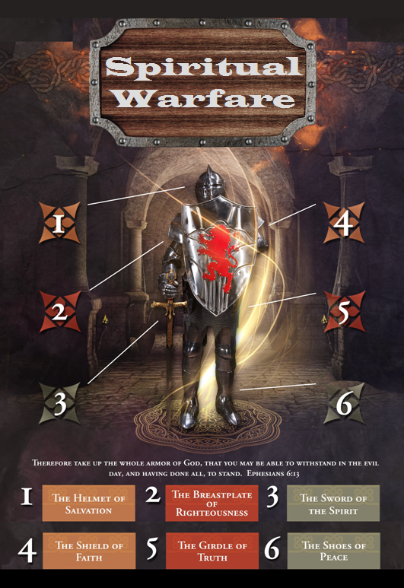

Slide 4
SPIRITUAL WARFARE
TEMPTATION
01 09-01 A Brief Look at Ephesians 6:12-18
Temptation’s 3 forms (1Jn. 2:15-17)
02 09-08 Temptations of Gen. 3 and Mt. 4; Jas 1
03 09-15 Scriptures explaining… The Lust of the Eyes
04 09-22 Scriptures explaining… The Lust of the Flesh
05 09-29 Scriptures explaining… The Pride of Life

Slide 5
SPIRITUAL WARFARE
DEFENSIVE WEAPONS
06 10-06 Defensive Weapons: Girdle and Breastplate
07 10-13 Defensive Weapons: Shoes and Shield
08 10-20 Defensive Weapons: Helmet and Sword

Slide 6
SPIRITUAL WARFARE
OFFENSIVE WEAPONS
09 10-27 Offensive Weapons: Prayer
10 11-03 Offensive Weapons: Praise
11 11-10 Offensive Weapons: Preaching
12 11-17 Offensive Weapons: Posture
13 11-24 Victory! (The Basis of Our Victory)

Slide 7
SPIRITUAL WARFARE
VICTORY!
The Basis of Our Victory
Victory is in Christ
We are More than Conquerors
Our Triumph is in Christ
Some Scriptures Concerning our Victory
All verses are from the
New American Standard Bible unless otherwise cited.

Slide 8
SPIRITUAL WARFARE
VICTORY!
Point One: Our Victory is in Christ
1Corinthians 15:57
Acts 10:36
2Corinthians 1:20

Slide 9
SPIRITUAL WARFARE
VICTORY!
Point Two: We are More than Conquerors
Romans 8:37
John 16:33
Romans 8:35

Slide 10
SPIRITUAL WARFARE
VICTORY!
Point Three: Our Triumph is in Christ
2Corinthians 2:14

Slide 11
SPIRITUAL WARFARE
VICTORY!
Summary:
1. God gives us the victory.
2. He makes us more than conquerors.
3. He makes us triumphant overcomers.
4. He brings us these victories through Jesus Christ.

Slide 12
SPIRITUAL WARFARE
VICTORY!
Summary:
5. Victory in Jesus is a free gift of God. We don’t have to earn it.
6. This God-given victory is broad-based (“in all these things”).
7. Ours is an “always” victory. It is not hit-or-miss.
8. We are made victorious because of Jesus’ love for us.

Slide 13
SPIRITUAL WARFARE
VICTORY!
Some Scriptures Concerning Posture:
Deuteronomy 20:4
Luke 12:32 John 16:33
Romans 8:1; 8:16-17
1Corinthians 15:56-57
2Corinthians 4:8-12
Ephesians 6:10,13
1John 4:4; 5:3-5
2Peter 1:10-11
Revelation 12:11; 15:2

Slide 14
SPIRITUAL WARFARE
THIS IS THE END OF OUR CLASS
THANK YOU AND MAY GOD BLESS

