Slide 3
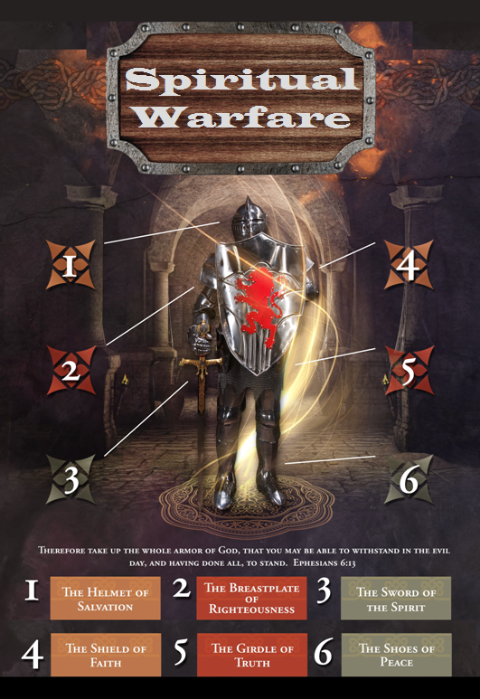

Slide 4
SPIRITUAL WARFARE
TEMPTATION
01 09-01 A Brief Look at Ephesians 6:12-18
Temptation’s 3 forms (1Jn. 2:15-17)
02 09-08 Temptations of Gen. 3 and Mt. 4; Jas 1
03 09-15 Scriptures explaining… The Lust of the Eyes
04 09-22 Scriptures explaining… The Lust of the Flesh
05 09-29 Scriptures explaining… The Pride of Life

Slide 5
SPIRITUAL WARFARE
DEFENSIVE WEAPONS
06 10-06 Defensive Weapons: Girdle and Breastplate
07 10-13 Defensive Weapons: Shoes and Shield
08 10-20 Defensive Weapons: Helmet and Sword

Slide 6
SPIRITUAL WARFARE
OFFENSIVE WEAPONS
09 10-27 Offensive Weapons: Prayer
10 11-03 Offensive Weapons: Praise
11 11-10 Offensive Weapons: Preaching
12 11-17 Offensive Weapons: Posture
13 11-24 Victory! (The Basis of Our Victory)

Slide 7
SPIRITUAL WARFARE
OFFENSIVE WEAPON OF PRAYER
Taking the Offensive
Building Up One Another
Battling the Devil
Some Scriptures on Prayer
blank
All verses are from the
New American Standard Bible unless otherwise cited.

Slide 8
SPIRITUAL WARFARE
PRAYER
TAKING THE OFFENSIVE
Scriptures concerning building up one another:
Romans 14:9
2Corinthians 10:8; 13:10
Ephesians 4:11-16
1Thessalonians 5:11
Jude 1:20

Slide 9
SPIRITUAL WARFARE
PRAYER
TAKING THE OFFENSIVE
Scriptures concerning battling the devil:
Deuteronomy 31:6
2Chronicles 20:15
Psalm 23:4; 46:1-3
Romans 8:38-39
2Timothy 1:7
James 4:7; 1Peter 5:8-9
Revelation 12:7-10

Slide 10
SPIRITUAL WARFARE
PRAYER
TAKING THE OFFENSIVE
Scriptures concerning prayer:
2Corinthians 10:4; Ephesians 6:18
Matthew 21:22; Luke 6:12
Acts 2:42; 6:4
Romans 12:12
Ephesians 1:16; Philippians 4:6
Colossians 4:2; 1Timothy 2:1-5
James 5:15-16; 1Peter 3:12; 4:7

Slide 11
SPIRITUAL WARFARE
NEXT WEEK:
THE FULL ARMOR OF GOD
(Eph. 6:18-20)
OFFENSIVE WEAPONS…
Praise
blank

