Slide 2
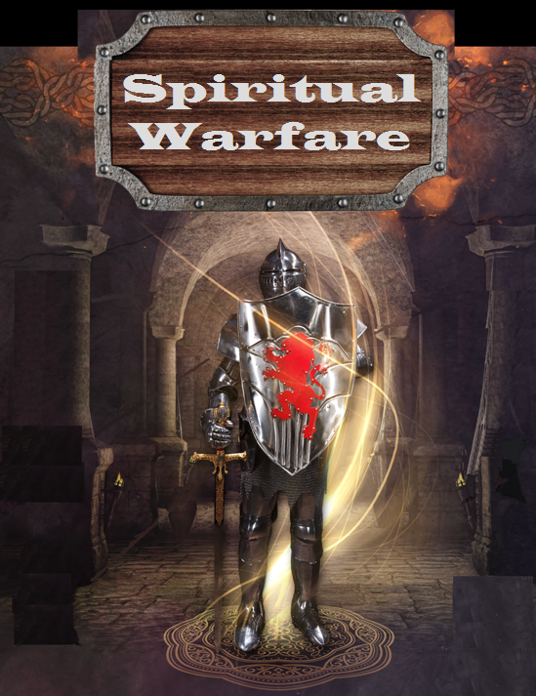

Slide 3
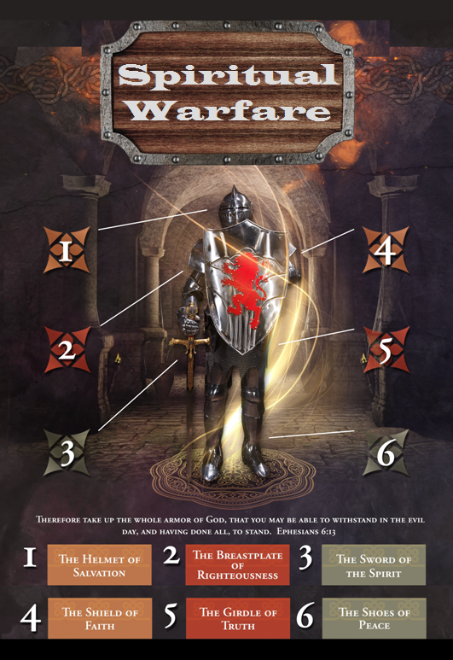

Slide 4
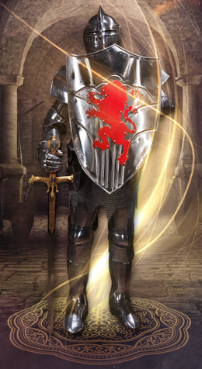
SPIRITUAL WARFARE
TEMPTATION
01 09-01 A Brief Look at Ephesians 6:12-18
Temptation’s 3 forms (1Jn. 2:15-17)
02 09-08 Temptations of Gen. 3 and Mt. 4; Jas 1
03 09-15 Scriptures explaining… The Lust of the Eyes
04 09-22 Scriptures explaining… The Lust of the Flesh
05 09-29 Scriptures explaining… The Pride of Life

Slide 5
SPIRITUAL WARFARE
DEFENSIVE WEAPONS
06 10-06 Defensive Weapons: Girdle and Breastplate
07 10-13 Defensive Weapons: Shoes and Shield
08 10-20 Defensive Weapons: Helmet and Sword

Slide 6
SPIRITUAL WARFARE
OFFENSIVE WEAPONS
09 10-27 Offensive Weapons: Prayer
10 11-03 Offensive Weapons: Praise
11 11-10 Offensive Weapons: Preaching
12 11-17 Offensive Weapons: Posture
13 11-24 Victory! (The Basis of Our Victory)

Slide 7
SPIRITUAL WARFARE
THE GIRDLE AND BREASTPLATE
The Full Armor of God
The Girdle of Truth
The Breastplate of Righteousness
blank
All verses are from the
New American Standard Bible unless otherwise cited.

Slide 8
SPIRITUAL WARFARE
THE FULL ARMOR OF GOD
The battleground…
2Corinthians 10:3-5
Achieving the task
Colossians 2:13-15; Hebrews 2:14-15
Spiritual equipment for the task
Ephesians 6:10-17
blank

Slide 9
SPIRITUAL WARFARE
THE GIRDLE OF TRUTH
The girdle is the truth.
Luke 1:3,4; 20:21
John 4:23-24; 8:32; 8:44; 14:6; 17:17
Romans 1:25
2Corinthians 4:2; 13:8
Galatians 4:16
2Thessalonians 2:10
1Timothy 2:3,4; 3:15
2Timothy 3:7; 4:4
1John 1:6-8; 2John v4
blank

Slide 10
SPIRITUAL WARFARE
THE BREASTPLATE OF RIGHTEOUSNESS
The breastplate protects the heart.
Passages on righteousness:
Matthew 5:6; 6:1; 6:33; 25:46
John 7:24
Acts 24:25
Romans 1:16-17; 3:10; 6:13; 6:16; 9:30; 10:4
Philippians 3:9
1Timothy 6:11
2Timothy 3:16
Titus 2:12
blank

Slide 11
SPIRITUAL WARFARE
NEXT WEEK:
THE FULL ARMOR OF GOD
(Eph. 6:10-17)
DEFENSIVE WEAPONS…
The Shoes and Shield
blank

