Slide 3
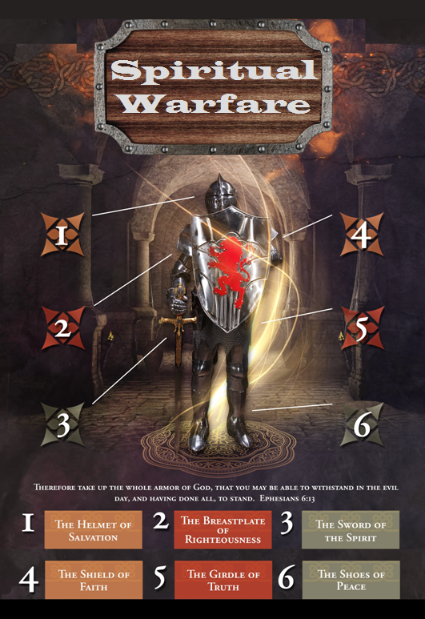

Slide 4
SPIRITUAL WARFARE
TEMPTATION
01 09-01 A Brief Look at Ephesians 6:12-18
Temptation’s 3 forms (1Jn. 2:15-17)
02 09-08 Temptations of Gen. 3 and Mt. 4; Jas 1
03 09-15 Scriptures explaining… The Lust of the Flesh
04 09-22 Scriptures explaining… The Lust of the Eye
05 09-29 Scriptures explaining… The Pride of Life

Slide 5
SPIRITUAL WARFARE
DEFENSIVE WEAPONS
06 10-06 Defensive Weapons: Girdle and Breastplate
07 10-13 Defensive Weapons: Shoes and Shield
08 10-20 Defensive Weapons: Helmet and Sword

Slide 6
SPIRITUAL WARFARE
OFFENSIVE WEAPONS
09 10-27 Offensive Weapons: Prayer
10 11-03 Offensive Weapons: Praise
11 11-10 Offensive Weapons: Preaching
12 11-17 Offensive Weapons: Posture
13 11-24 Victory! (The Basis of Our Victory)

Slide 7
SPIRITUAL WARFARE
THREE TEMPTATIONS
SOME THOUGHTS ON Genesis 3:1-6
Matthew 4:1-11
James 1:13-16
All verses are from the
New American Standard Bible unless otherwise cited.

Slide 8
SPIRITUAL WARFARE
THOUGHTS ON Genesis 3:1-6
Flashback to 1John 2:16
The things mentioned by John in this verse have come to be called "the three avenues of temptation."
A. The triple temptation of Eve (Gen. 3:1-6):
1. The fruit was good to eat (flesh).
2. Beautiful to see (eyes).
3. Would make one as God, knowing good and evil (vain glory).

Slide 9
SPIRITUAL WARFARE
THOUGHTS ON Genesis 3:1-6.
The devil’s wiles:
1. He attacked the woman while she was alone.
2. He introduced doubt in her mind.
3. He ignored God's covenant with man.
4. He denied the connection between sin and punishment.
5. He challenged divine veracity.
6. He charged God with jealousy.
7. He appealed to pride and ambition.

Slide 10
SPIRITUAL WARFARE
THOUGHTS ON Genesis 3:1-6.
The woman's downfall:
1. She listened (3:2,3).
2. She loosened (3:3).
3. She looked (3:6).
4. She longed for (3:6).
5. She laid hold on (3:6).
6. She lured another to partake (3:6).

Slide 11
SPIRITUAL WARFARE
THOUGHTS ON Genesis 3:1-6.
The consequences of man's fall:
1. Loss of innocence -- they knew they were naked
2. Shame --they attempted to cover themselves.
3. Fear -- they hid themselves.
4. Death -- separation from the tree of life.
5. Adam's sin caused these results:
a. Adam must labor and work for the sustenance of life.
b. Eve's must suffer increased pain in child birth and submission to man.

Slide 12
SPIRITUAL WARFARE
THOUGHTS ON Genesis 3:1-6.
How Satan worked on Eve in the Garden:
1. He tempted her with the desire to be like God (3:5).
2. He deceived her by saying she would not die (3:4).
3. She acted in disobedience by eating the fruit (3:6).
4. The result was spiritual and physical death (3:19-24).

Slide 13
SPIRITUAL WARFARE
THOUGHTS ON Matthew 4:1-11
Flashback to 1John 2:16
The things mentioned by John in this verse have come to be called "the three avenues of temptation."
The triple temptation of Christ (Mt. 4:1-11):
1. He was hungry (flesh).
2. Satan showed him all the kingdoms of the world (eyes).
3. The vainglorious triumph of leaping from the parapet of the temple unharmed.

Slide 14
SPIRITUAL WARFARE
THOUGHTS ON Matthew 4:1-11.
The first temptation (4:1-4):
Then Jesus was led up by the Spirit into the wilderness to be tempted by the devil. [2] And after He had fasted forty days and forty nights, He then became hungry. [3] And the tempter came and said to Him, “If You are the Son of God, command that these stones become bread.” [4] But He answered and said, “It is written, ‘MAN SHALL NOT LIVE ON BREAD ALONE, BUT ON EVERY WORD THAT PROCEEDS OUT OF THE MOUTH OF GOD.’”

Slide 15
SPIRITUAL WARFARE
THOUGHTS ON Matthew 4:1-11.
The second temptation (4:5-7):
Then the devil took Him into the holy city; and he had Him stand on the pinnacle of the temple, [6] and said to Him, “If You are the Son of God throw Yourself down; for it is written, ‘HE WILL GIVE HIS ANGELS CHARGE CONCERNING YOU’; and ‘ON their HANDS THEY WILL BEAR YOU UP, LEST YOU STRIKE YOUR FOOT AGAINST A STONE.’” [7] Jesus said to him, “On the other hand, it is written, ‘YOU SHALL NOT PUT THE LORD YOUR GOD TO THE TEST.’”

Slide 16
SPIRITUAL WARFARE
THOUGHTS ON Matthew 4:1-11.
The third temptation (4:8-11):
Again, the devil took Him to a very high mountain, and showed Him all the kingdoms of the world, and their glory; [9] and he said to Him, “All these things will I give You, if You fall down and worship me.” [10] Then Jesus said to him, “Begone, Satan! For it is written, ‘YOU SHALL WORSHIP THE LORD YOUR GOD, AND SERVE HIM ONLY.’” [11] Then the devil left Him; and behold, angels came and began to minister to Him.

Slide 17
SPIRITUAL WARFARE
THOUGHTS ON James 1:13-16.
The text:
Let no one say when he is tempted, “I am being tempted by God”; for God cannot be tempted by evil, and He Himself does not tempt anyone. [14] But each one is tempted when he is carried away and enticed by his own lust. [15] Then when lust has conceived, it gives birth to sin; and when sin is accomplished, it brings forth death. [16] Do not be deceived, my beloved brethren.

Slide 18
SPIRITUAL WARFARE
THOUGHTS ON James 1:13-16.
First, there is desire (1:14):
The word lust means any kind of desire, and not necessarily sexual passions. The normal desires of life were given to us by God, and, of themselves, are not sinful.
Eating is normal... gluttony is sin.
Sleep is normal... laziness is sin.
Marriage is honorable... fornication is sin.

Slide 19
SPIRITUAL WARFARE
THOUGHTS ON James 1:13-16.
Second, there is deception (1:14):
1. No temptation appears as temptation; it is always seems more alluring than it really is.
2. “Drawn away” carries with it the idea of the baiting of a trap; and “enticed” in the Gk., means “to bait a hook.”
3. The bait not only attracts us, but it hides the fact that yielding to it will eventually bring sorrow and punishment. The bait keeps us from seeing the consequences of our sin.

Slide 20
SPIRITUAL WARFARE
THOUGHTS ON James 1:13-16.
Third, there is disobedience (1:15):
1. We have moved from the emotions (desire) and the intellect (deception) to the will.
2. Desire conceives a method for taking the bait; the intellect approves it, and the will acts!
3. Disobedience is an act of will. The more you exercise your will in saying no to temptation the more God will take control of your life.

Slide 21
SPIRITUAL WARFARE
THOUGHTS ON James 1:13-16.
Fourth, there is death (1:15):
1. Disobedience gives birth to death, not life. The devil promises life, but gives death. It may take years for the sin to mature, but when it does, the result is death.
2. Let us believe God’s word now, correct the situation, so it will not become tragedy.

Slide 22
SPIRITUAL WARFARE
THOUGHTS ON James 1:13-16.
Summary:
1. There is… desire.
2. There is… deception.
3. There is… disobedience.
4. There is… death.

Slide 23
SPIRITUAL WARFARE
NEXT WEEK:
Scriptures explaining…
The Lust of the Eyes
Definition and Examples
Old Testament Scriptures
New Testament Scriptures

