Slide 3
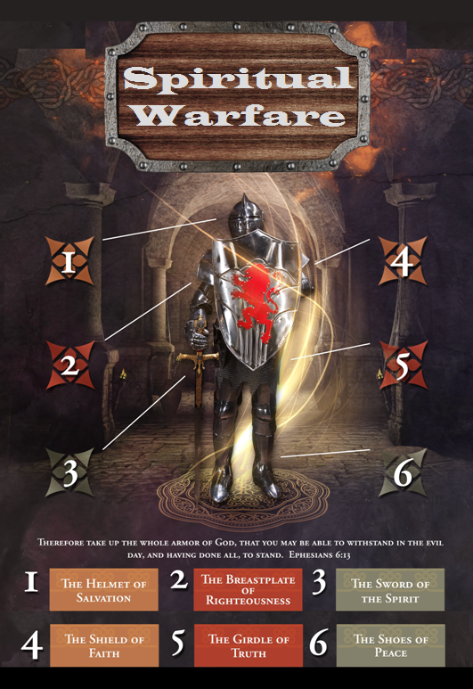

Slide 4
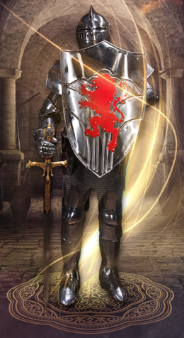
SPIRITUAL WARFARE
TEMPTATION
01 09-01 A Brief Look at Ephesians 6:12-18
Temptation’s 3 forms (1Jn. 2:15-17)
02 09-08 Temptations of Gen. 3 and Mt. 4; Jas 1
03 09-15 Scriptures explaining… The Lust of the Flesh
04 09-22 Scriptures explaining… The Lust of the Eye
05 09-29 Scriptures explaining… The Pride of Life

Slide 5
SPIRITUAL WARFARE
DEFENSIVE WEAPONS
06 10-06 Defensive Weapons: Girdle and Breastplate
07 10-13 Defensive Weapons: Shoes and Shield
08 10-20 Defensive Weapons: Helmet and Sword

Slide 6
SPIRITUAL WARFARE
OFFENSIVE WEAPONS
09 10-27 Offensive Weapons: Prayer
10 11-03 Offensive Weapons: Praise
11 11-10 Offensive Weapons: Preaching
12 11-17 Offensive Weapons: Posture
13 11-24 Victory! (The Basis of Our Victory)

Slide 7
SPIRITUAL WARFARE
TEMPTATION
01 09-01 A Brief Look at Ephesians 6:12-18
Temptation’s 3 forms (1Jn. 2:15-17)
02 09-08 Temptations of Gen. 3 and Mt. 4; Jas 1
03 09-15 Scriptures explaining… The Lust of the Flesh
04 09-22 Scriptures explaining… The Lust of the Eye
05 09-29 Scriptures explaining… The Pride of Life

Slide 8
SPIRITUAL WARFARE
INTRODUCTION TO SPIRITUAL WARFARE
SOME THOUGHTS ON Ephesians 6:12
Ephesians 6:14-17
1John 2:16
All verses are from the
New American Standard Bible unless otherwise cited.

Slide 9
SPIRITUAL WARFARE
THOUGHTS ON Ephesians 6:12.
The text:
For our struggle is not against flesh and blood, but against the rulers, against the powers, against the world forces of this darkness, against the spiritual forces of wickedness in the heavenly places.
1Corinthians 9:25-27

Slide 10
SPIRITUAL WARFARE
THOUGHTS ON Ephesians 6:12.
The text:
For our struggle is not against flesh and blood, but against the rulers, against the powers, against the world forces of this darkness, against the spiritual forces of wickedness in the heavenly places.
Galatians 1:6

Slide 11
SPIRITUAL WARFARE
THOUGHTS ON Ephesians 6:12.
The text:
For our struggle is not against flesh and blood, but against the rulers, against the powers, against the world forces of this darkness, against the spiritual forces of wickedness in the heavenly places.
Galatians 1:6

Slide 12
SPIRITUAL WARFARE
THOUGHTS ON Ephesians 6:12.
The text:
For our struggle is not against flesh and blood, but against the rulers, against the powers, against the world forces of this darkness, against the spiritual forces of wickedness in the heavenly places.
Ephesians 2:2

Slide 13
SPIRITUAL WARFARE
THOUGHTS ON Ephesians 6:12.
The text:
For our struggle is not against flesh and blood, but against the rulers, against the powers, against the world forces of this darkness, against the spiritual forces of wickedness in the heavenly places.
Ephesians 2:2 Ephesians 1:3; 1:20
Colossians 1:13 Ephesians 2:6; 3:10
Ephesians 6:12

Slide 14
SPIRITUAL WARFARE
THOUGHTS ON Ephesians 6:14-17.
The text:
Stand firm therefore, HAVING GIRDED YOUR LOINS WITH TRUTH, and HAVING PUT ON THE BREASTPLATE OF RIGHTEOUSNESS, [15] and having shod YOUR FEET WITH THE PREPARATION OF THE GOSPEL OF PEACE; [16] in addition to all, taking up the shield of faith with which you will be able to extinguish all the flaming arrows of the evil one. [17] And take THE HELMET OF SALVATION, and the sword of the Spirit, which is the word of God.
Six pieces of armor.

Slide 15
SPIRITUAL WARFARE
THOUGHTS ON Ephesians 6:14-17.
The text:
Stand firm therefore, HAVING GIRDED YOUR LOINS WITH TRUTH, and HAVING PUT ON THE BREASTPLATE OF RIGHTEOUSNESS, [15] and having shod YOUR FEET WITH THE PREPARATION OF THE GOSPEL OF PEACE; [16] in addition to all, taking up the shield of faith with which you will be able to extinguish all the flaming arrows of the evil one. [17] And take THE HELMET OF SALVATION, and the sword of the Spirit, which is the word of God.
The girdle of truth.

Slide 16
SPIRITUAL WARFARE
THOUGHTS ON Ephesians 6:14-17.
The text:
Stand firm therefore, HAVING GIRDED YOUR LOINS WITH TRUTH, and HAVING PUT ON THE BREASTPLATE OF RIGHTEOUSNESS, [15] and having shod YOUR FEET WITH THE PREPARATION OF THE GOSPEL OF PEACE; [16] in addition to all, taking up the shield of faith with which you will be able to extinguish all the flaming arrows of the evil one. [17] And take THE HELMET OF SALVATION, and the sword of the Spirit, which is the word of God.
The breastplate of righteousness.

Slide 17
SPIRITUAL WARFARE
THOUGHTS ON Ephesians 6:14-17.
The text:
Stand firm therefore, HAVING GIRDED YOUR LOINS WITH TRUTH, and HAVING PUT ON THE BREASTPLATE OF RIGHTEOUSNESS, [15] and having shod YOUR FEET WITH THE PREPARATION OF THE GOSPEL OF PEACE; [16] in addition to all, taking up the shield of faith with which you will be able to extinguish all the flaming arrows of the evil one. [17] And take THE HELMET OF SALVATION, and the sword of the Spirit, which is the word of God.
The shoes of peace.

Slide 18
SPIRITUAL WARFARE
THOUGHTS ON Ephesians 6:14-17.
The text:
Stand firm therefore, HAVING GIRDED YOUR LOINS WITH TRUTH, and HAVING PUT ON THE BREASTPLATE OF RIGHTEOUSNESS, [15] and having shod YOUR FEET WITH THE PREPARATION OF THE GOSPEL OF PEACE; [16] in addition to all, taking up the shield of faith with which you will be able to extinguish all the flaming arrows of the evil one. [17] And take THE HELMET OF SALVATION, and the sword of the Spirit, which is the word of God.
The shield of faith.

Slide 19
SPIRITUAL WARFARE
THOUGHTS ON Ephesians 6:14-17.
The text:
Stand firm therefore, HAVING GIRDED YOUR LOINS WITH TRUTH, and HAVING PUT ON THE BREASTPLATE OF RIGHTEOUSNESS, [15] and having shod YOUR FEET WITH THE PREPARATION OF THE GOSPEL OF PEACE; [16] in addition to all, taking up the shield of faith with which you will be able to extinguish all the flaming arrows of the evil one. [17] And take THE HELMET OF SALVATION, and the sword of the Spirit, which is the word of God.
The helmet of salvation.

Slide 20
SPIRITUAL WARFARE
THOUGHTS ON Ephesians 6:14-17.
The text:
Stand firm therefore, HAVING GIRDED YOUR LOINS WITH TRUTH, and HAVING PUT ON THE BREASTPLATE OF RIGHTEOUSNESS, [15] and having shod YOUR FEET WITH THE PREPARATION OF THE GOSPEL OF PEACE; [16] in addition to all, taking up the shield of faith with which you will be able to extinguish all the flaming arrows of the evil one. [17] And take THE HELMET OF SALVATION, and the sword of the Spirit, which is the word of God.
The sword of the Spirit.

Slide 21
SPIRITUAL WARFARE
THOUGHTS ON 1John 2:16.
The text:
For all that is in the world, the lust of the flesh and the lust of the eyes and the boastful pride of life, is not from the Father, but is from the world.

Slide 22
SPIRITUAL WARFARE
THOUGHTS ON 1John 2:16.
The text:
For all that is in the world, the lust of the flesh and the lust of the eyes and the boastful pride of life, is not from the Father, but is from the world.
The term ‘world’ in this verse does not mean creation.
Romans 12:1-2
1John 5:19
Colossians 2:8

Slide 23
SPIRITUAL WARFARE
THOUGHTS ON 1John 2:16.
The text:
For all that is in the world, the lust of the flesh and the lust of the eyes and the boastful pride of life, is not from the Father, but is from the world.
James 1:14
Romans 6:12; 13:14
1Peter 1:14

Slide 24
SPIRITUAL WARFARE
THOUGHTS ON 1John 2:16.
The text:
For all that is in the world, the lust of the flesh and the lust of the eyes and the boastful pride of life, is not from the Father, but is from the world.
Matthew 5:27-28
1Thessalonians 4:5
Titus 3:3

Slide 25
SPIRITUAL WARFARE
THOUGHTS ON 1John 2:16.
The text:
For all that is in the world, the lust of the flesh and the lust of the eyes and the boastful pride of life, is not from the Father, but is from the world.
1Timothy 3:6
2Peter 3:3
Jude 1:16,18

Slide 26
SPIRITUAL WARFARE
CONCLUSION:
The things mentioned by John in this verse have come to be called "the three avenues of temptation."
A. The triple temptation of Eve (Gen. 3:1-6):
1. The fruit was good to eat (flesh).
2. Beautiful to see (eyes).
3. Would make one as God, knowing good and evil (vain glory).

Slide 27
SPIRITUAL WARFARE
CONCLUSION:
The things mentioned by John in this verse have come to be called "the three avenues of temptation."
B. And the triple temptation of Christ (Mt. 4:1-11):
1. He was hungry (flesh).
2. Satan showed him all the kingdoms of the world(eyes).
3. The vainglorious triumph of leaping from the parapet of the temple unharmed.

Slide 28
SPIRITUAL WARFARE
NEXT WEEK:
THOUGHTS ON Genesis 3:1-6
Matthew 4:1-11
James 1:13-16

