Slide 1
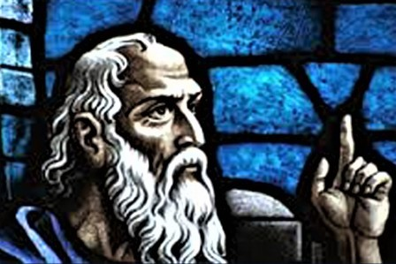
THE MODERN DAY MINOR PROPHETS
How the minor prophets’ message
is still relevant in our modern society.

Slide 2
THE MODERN DAY MINOR PROPHETS
-- TIMELINE --

Slide 3
THE MODERN DAY MINOR PROPHETS
-- REVIEW --
Hosea 760-722 B.C.
God’s love for Israel in the midst of Israel’s unfaithfulness.
Joel 810-750 B.C.
The “Day of the Lord”
—both for judgment and for hope
Amos 760 B.C.
Social injustices are seen as sins against God. Empty “religion” does not reflect a true spiritual and ethical relationship with God.

Slide 4
THE MODERN DAY MINOR PROPHETS
-- REVIEW --
Obadiah 587 B.C.
Israel and Edom. Arrogance and pride lead to downfall.
Jonah 760 B.C.
Repentance and God’s mercy—and our own attitudes to others who are recipients of that mercy.
Micah 740-687 B.C.
God’s judgment on sin.

Slide 5
THE MODERN DAY MINOR PROPHETS
-- REVIEW --
Nahum 630-612 B.C.
God’s punishment of Assyria and its capital, Nineveh.
Habakkuk 600 B.C.
We can trust God, even though as finite beings we cannot always see the reasons God allows evil.
Zephaniah 640-610 B.C.
Judgment and hope both for Israel and the nations as the prophet predicts the Day of the Lord and the salvation of a “remnant.”

Slide 6
THE MODERN DAY MINOR PROPHETS
-- REVIEW --
Haggai 520 B.C.
Encouragement to rebuild the Temple.
Zechariah 520 B.C.
Building up the community that had returned from exile and the future redemption of the nations of the world—all to take place under godly leadership.
Malachi 450 B.C.
Covenant relationships. A warning to the priests and people.

Slide 7
THE MODERN DAY MINOR PROPHETS
-- REVIEW --
My takeaways from the Minor Prophets:
1. God is sovereign.
2. God demands obedience to His commands.
3. God will punish the unfaithful.
4. God will reward the remnant.

Slide 8
THE MODERN DAY MINOR PROPHETS
How the minor prophets’ message
is still relevant in our modern society.

