Slide 1
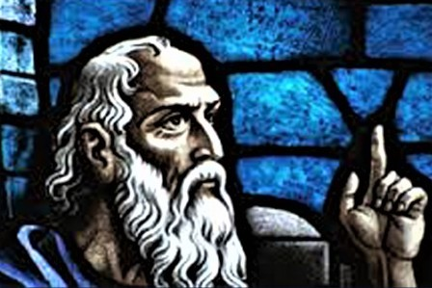
THE MODERN DAY MINOR PROPHETS
How the minor prophets’ message
is still relevant in our modern society.

Slide 2
THE MODERN DAY MINOR PROPHETS
06-01 Hosea God is Righteousness and Love
Israel Plays the Harlot with God
06-08 Joel The Day of Jehovah
The Prophet of Pentecost
06-15 Amos God is Justice and Righteousness
Doom for Judah
06-22 Obadiah The Fall of Edom because of Cruelty
God Rules the Nations
06-29 Congregational Prayer Night

Slide 3
THE MODERN DAY MINOR PROPHETS
07-06 Jonah God will save the penitent heathen
The Reluctant Prophet
07-13 Micah God is a God of Ethics
True Religion Among the Sins of Judah
07-20 Nahum The Doom of Nineveh
God's Holy Anger
07-27 Habakkuk
God’s Universal Judgment
Faithfulness guarantees permanency

Slide 4
THE MODERN DAY MINOR PROPHETS
08-03 Zephaniah The Day of Jehovah is at Hand
Doom Awaits the Unfaithful
08-10 Haggai Build the Temple!
God Will Bless Those Who Build
08-17 Zechariah Build the Temple and God will Bless
The Messiah is Coming
08-24 Malachi Judgment is Coming
God is Not Served by Partial Service
08-31 Congregational Prayer Meeting

Slide 5
THE MODERN DAY MINOR PROPHETS
-- TIMELINE --

Slide 6
THE MODERN DAY MINOR PROPHETS
-- OBADIAH --
The Fall of Edom because of Cruelty
God Rules the Nations
● Name and Personality of the Prophet.
● Date of the Book and of the Prophet.
● Outline and Supplemental Thoughts.
● Theme and Message of the Book.
● Practical Lessons of Permanent Value.
● Discussion Questions.

Slide 7
THE MODERN DAY MINOR PROPHETS
-- OBADIAH --
NAME AND PERSONALITY OF THE PROPHET
A. We know very little about the author, Obadiah.
B. He is not to be confused with the other Obadiahs of the OT.
C. The name Obadiah means “worshipper of God” or “servant of God.”
D. The work produced is more important than the worker.

Slide 8
THE MODERN DAY MINOR PROPHETS
-- OBADIAH --
DATE OF THE BOOK AND PROPHET
A. Two dates have been suggested 845bc and 586bc.
B. There are several reasons to accept the early date:
1. Judah will again subjugate Edom (see v17 and 2Chr. 25:5-14).
2. During the 586bc destruction Obadiah omits these things:
a. The razing of the walls (2Kgs. 25:10).
b. The burning of the royal palace (2Kgs. 25:9).
c. The burning of the temple (2Kgs. 25:9).

Slide 9
THE MODERN DAY MINOR PROPHETS
-- OBADIAH --
DATE OF THE BOOK AND PROPHET
3. The bitterness between the Israelites and Edomites was at its greatest when the Edomites joined forces with foreigners to besiege and capture Judah in 848-841bc. See 2Chr. 21:16:17.

Slide 10
THE MODERN DAY MINOR PROPHETS
-- OBADIAH --
OUTLINE
I. Edom’s Destruction.
A. Announcement of Judgment (v1-9).
B. Reasons for Judgment (v10-14)
C. Severity of the Judgment (v15-16).
II. Israel’s Salvation.
A. The remnant to escape (v17).
B. The conquest of Edom & other nations (v18-20).
C. God’s rule from Mount Zion (v21).

Slide 11
THE MODERN DAY MINOR PROPHETS
-- OBADIAH --
SUPPLEMENTAL THOUGHTS
Explanatory Introduction:
A. Communication: “The vision of Obadiah.”
B. Source: “Thus says the Lord God.”
C. Object: Edom.
D. Subject: There is a movement among the nations against Edom.

Slide 12
THE MODERN DAY MINOR PROPHETS
-- OBADIAH --
SUPPLEMENTAL THOUGHTS
Judgment Declared:
A. God is going to make Edom despised among the nations.
B. Edom’s pride has deceived her.
C. “I will bring you down” says the Lord.
D. The destruction of Edom is to be complete.
E. Edom’s allies will turn against her.
F. Edom’s wise and mighty men will fail her; she is doomed.

Slide 13
THE MODERN DAY MINOR PROPHETS
-- OBADIAH --
SUPPLEMENTAL THOUGHTS
The Cause of Edom’s Judgment:
A. Violence done to his brother Jacob.
B. Standing aloof and then joined the enemies.

Slide 14
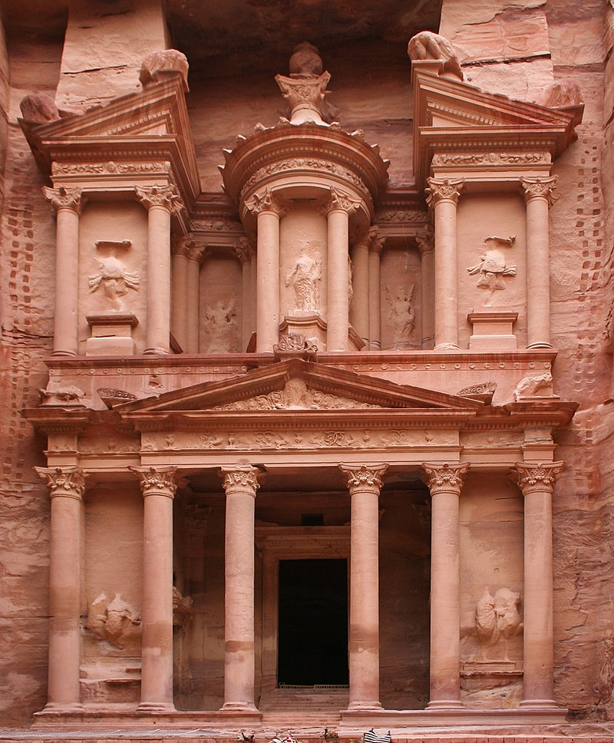
THE MODERN DAY MINOR PROPHETS
-- OBADIAH --
SUPPLEMENTAL PICTURES
By Diego Delso, CC BY-SA 3.0, https://commons.wikimedia.org/w/index.php?curid=17901966

Slide 15
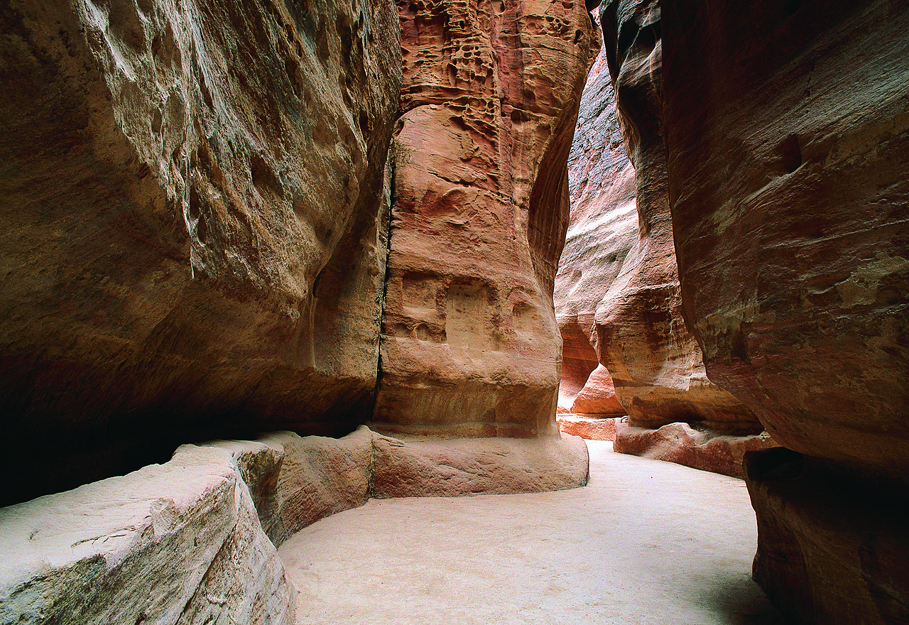
THE MODERN DAY MINOR PROPHETS
-- OBADIAH --
By Diego Delso, CC BY-SA 3.0, https://commons.wikimedia.org/w/index.php?curid=17901966

Slide 16
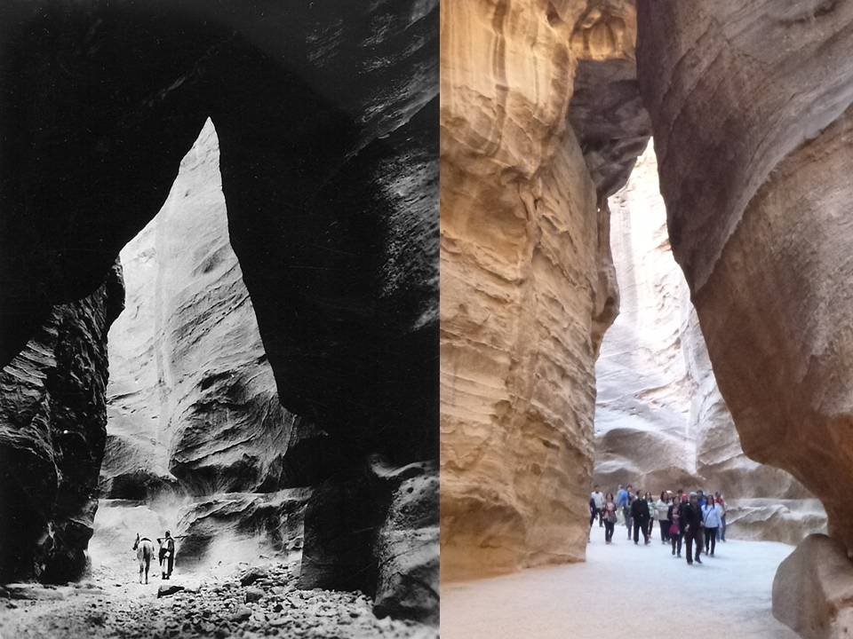
THE MODERN DAY MINOR PROPHETS
-- OBADIAH --
By Diego Delso, CC BY-SA 3.0, https://commons.wikimedia.org/w/index.php?curid=17901966

Slide 17
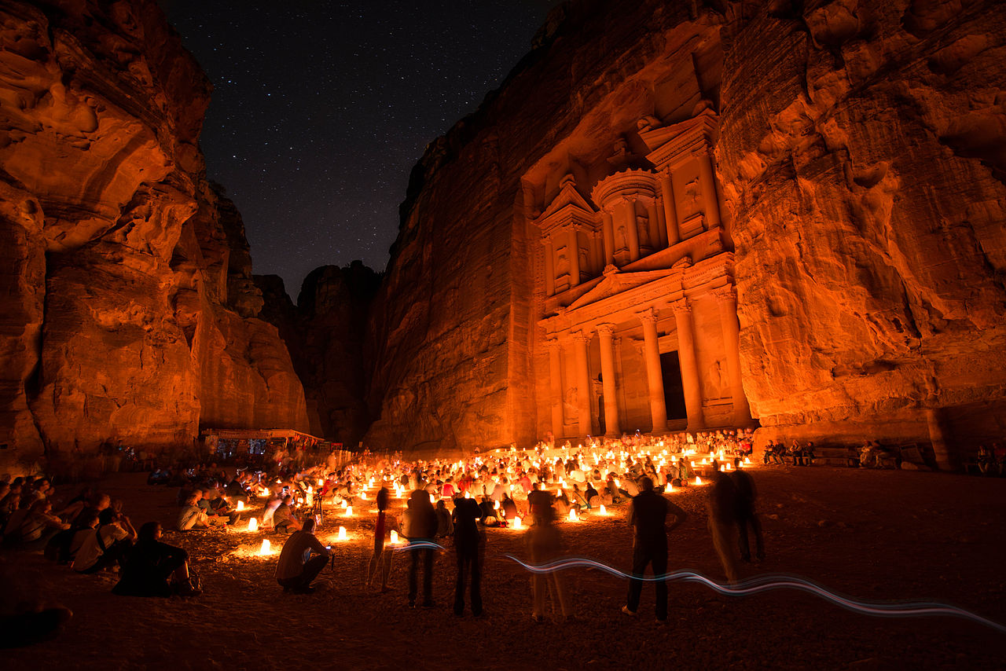
THE MODERN DAY MINOR PROPHETS
-- OBADIAH --
By Diego Delso, CC BY-SA 3.0, https://commons.wikimedia.org/w/index.php?curid=17901966

Slide 18
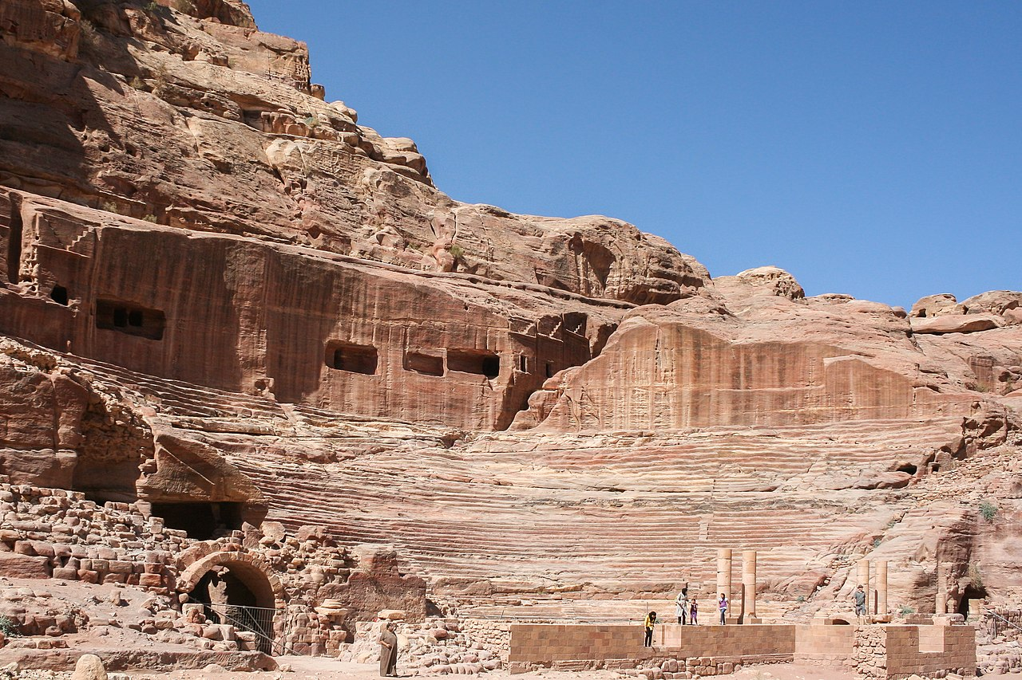
THE MODERN DAY MINOR PROPHETS
-- OBADIAH --
By Diego Delso, CC BY-SA 3.0, https://commons.wikimedia.org/w/index.php?curid=17901966

Slide 19
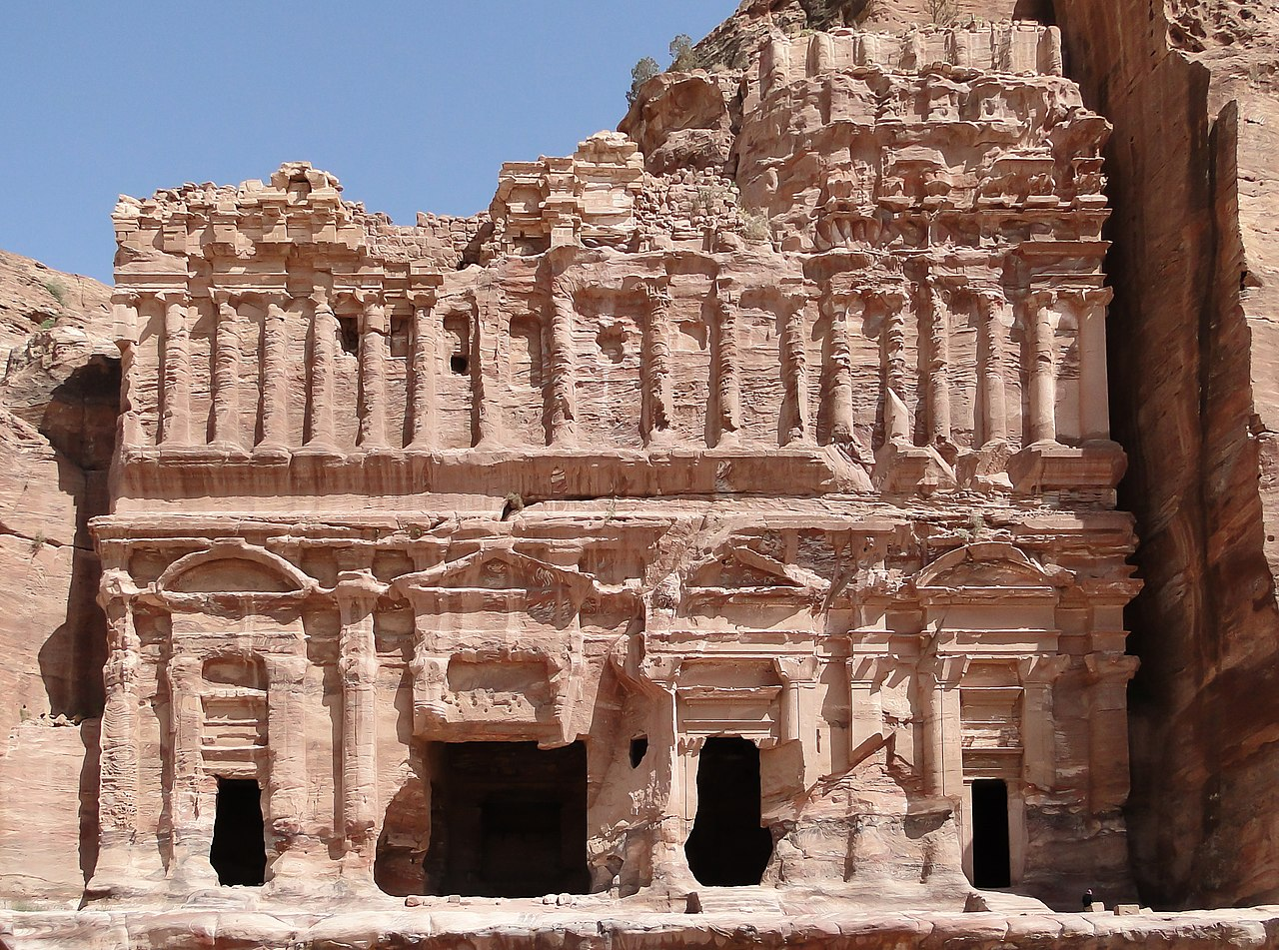
THE MODERN DAY MINOR PROPHETS
-- OBADIAH --
By Diego Delso, CC BY-SA 3.0, https://commons.wikimedia.org/w/index.php?curid=17901966

Slide 20
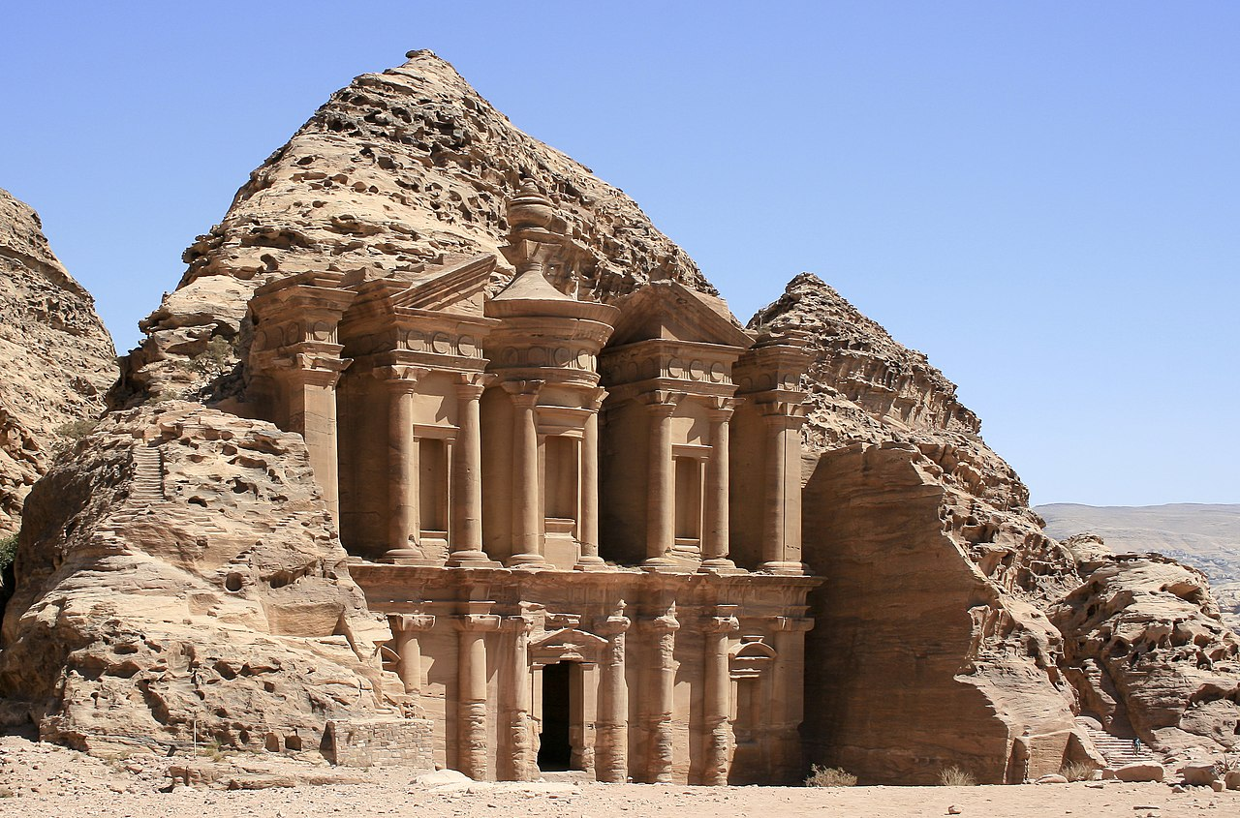
THE MODERN DAY MINOR PROPHETS
-- OBADIAH --
By Diego Delso, CC BY-SA 3.0, https://commons.wikimedia.org/w/index.php?curid=17901966

Slide 21
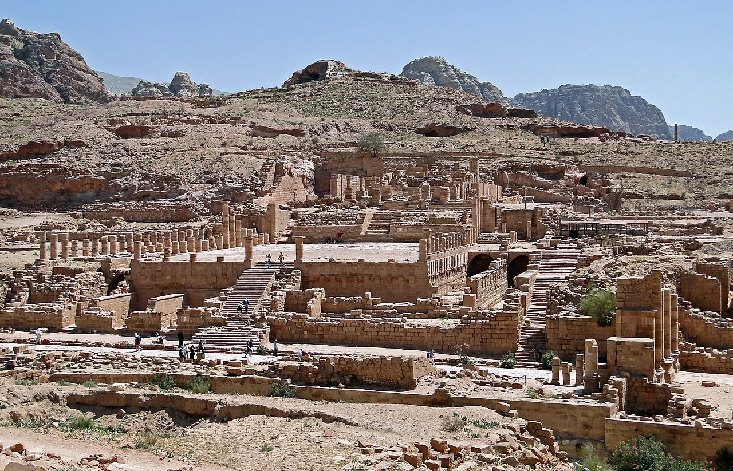
THE MODERN DAY MINOR PROPHETS
-- OBADIAH --
By Diego Delso, CC BY-SA 3.0, https://commons.wikimedia.org/w/index.php?curid=17901966

Slide 22
THE MODERN DAY MINOR PROPHETS
-- OBADIAH --
THEME AND MESSAGE OF THE BOOK
A. The theme of the book of Obadiah is:
The fall of Edom because of cruelty.
B. The message of the book of Obadiah is:
God rules in the Nations.
C. Lessons that can be applied are:
1. The consequence of pride (a stronghold that is not strong).
2. The violence of silence (sin of neutrality).

Slide 23
THE MODERN DAY MINOR PROPHETS
-- OBADIAH --
PRACTICAL LESSONS OF PERMANENT VALUE
A. Human defenses are utterly useless when the power of God comes against them.
B. Ridicule is always bad for it reveals a low human pride that means an utter lack of brotherly love.
C. Eternal justice will prevail.
D. Pride goes before a fall.
E. There can be violence in silence (the sin of neutrality).

Slide 24
THE MODERN DAY MINOR PROPHETS
-- OBADIAH --
DISCUSSION QUESTIONS
A. What is at the root of bitter feuds? What is so powerful that the participants don’t even desire to end the feud?
B. What is the worst example of a feud that you know of?
C. What is the answer to a long-standing, bitter feud? How might this affect your country’s foreign policy?
D. How do you see God’s sovereignty at work in the world? What can we do to cooperate with his plans?

Slide 25
THE MODERN DAY MINOR PROPHETS
-- OBADIAH --
DISCUSSION QUESTIONS
E. How should it affect our actions to know that God reigns over all of history?
F. Why does God especially hate prideful arrogance in people and nations?
G. For which sins was God going to judge Edom? Why is this helpful for us to reflect on?
H. When has application of the Golden Rule influenced your behavior?
I. What can we hope for in the future? How can we nurture this hope and keep it fresh and alive?

Slide 26
THE MODERN DAY MINOR PROPHETS
Next week:
06-01 Hosea God is Righteousness and Love
Israel Plays the Harlot with God
06-08 Joel The Day of Jehovah
The Prophet of Pentecost
06-15 Amos God is Justice and Righteousness
Doom for Judah
06-22 Obadiah The Fall of Edom because of Cruelty
God Rules the Nations
06-29 Congregational Prayer Night

Slide 27
THE MODERN DAY MINOR PROPHETS
How the minor prophets’ message
is still relevant in our modern society.

