Slide 1
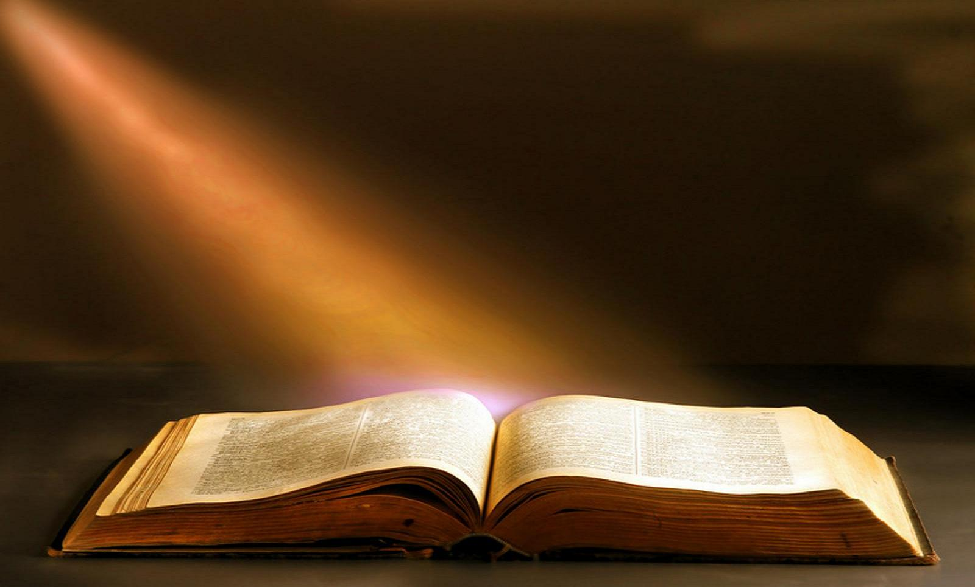
The 20 Greatest Chapters
in the Bible

Slide 2
The 20 Greatest Chapters in the Bible
Genesis 01
Exodus 20
Psalms 01
Psalms 23
Psalms 51
Psalms 119
Proverbs 31
Isaiah 40
Isaiah 53
Matthew 05
Matthew 06
Matthew 07
John 17
Acts 02
Romans 08
1Corinthians 13
1Corinthians 15
Ephesians 02
Hebrews 11
James 02

Slide 3
The 20 Greatest Chapters in the Bible
Psalms, Chapter 1
UNDERSTANDING THE PSALMS.
THE BLESSEDNESS OF RIGHTEOUSNESS
THE FATE OF THE WICKED
GOD KNOWS

Slide 4
The 20 Greatest Chapters in the Bible
Psalms, Chapter 1
Psalms is a unique book of the Bible.
It is the longest book.
It is the center book.
It is a song book.
It is the book most frequently quoted in the NT.

Slide 5
The 20 Greatest Chapters in the Bible
Psalms, Chapter 1
Psalms was written by several individuals:
1. The source of them all is God.
2. The oldest manuscripts have inscriptions at the beginning of some of the psalms giving authors, and sometimes, circumstances of the writing.
3. These inscriptions are very old.

Slide 6
The 20 Greatest Chapters in the Bible
Psalms, Chapter 1
Psalms was written by several individuals:
4. They attribute psalms to:
a. David = 73 psalms.
b. Solomon = 2 psalms.
c. Ethan = 1 psalm.
d. Sons of Koran = 8-10 psalms.
e. Asaph = 12 psalms.
f. Moses = 1 psalm.
g. Heman = 1 psalm.
h. No heading given for nearly 50 psalms.

Slide 7
The 20 Greatest Chapters in the Bible
Psalms, Chapter 1
Psalms are “profitable for doctrine” (2Tim. 3:16,17):
1. It is the most frequently quoted book of the OT by NT writers.
2. It is quoted to establish doctrine.
3. Psalms are frequently quoted as “He says,” (God) or “the Holy Spirit says.”

Slide 8
The 20 Greatest Chapters in the Bible
Psalms, Chapter 1
The book of Psalms is divided into five parts like the books of the Law of Moses:
1. Psalms 001-041; about man and creation - corresponds to Genesis.
2. Psalms 042-072; about Israel and redemption - corresponds to Exodus.
3. Psalms 073-089; about worship and the temple - corresponds to Leviticus.
4. Psalms 096-106; about our sojourn on the earth - corresponds to Numbers.
5. Psalms 107-150; about praise and the word of God - corresponds to Deuteronomy.

Slide 9
The 20 Greatest Chapters in the Bible
Psalms, Chapter 1
PSALM 1:1-3.
How blessed is the man who does not walk in the counsel of the wicked, Nor stand in the path of sinners, Nor sit in the seat of scoffers!
[2] But his delight is in the law of the LORD, And in His law he meditates day and night.
[3] And he will be like a tree firmly planted by streams of water, Which yields its fruit in its season, And its leaf does not wither; And in whatever he does, he prospers.

Slide 10
The 20 Greatest Chapters in the Bible
Psalms, Chapter 1
THE BLESSEDNESS OF THE RIGHTEOUS.
The righteous man is characterized by:
1. His abstention from evil (1:1).
Notice the thrice-repeated formula of verse 1:
a. The righteous person does not … walk, stand, or sit.
b. They do not take their place in… counsel, way, or seat.
c. They are not like the… wicked, sinners, or scoffers.

Slide 11
The 20 Greatest Chapters in the Bible
Psalms, Chapter 1
THE BLESSEDNESS OF THE RIGHTEOUS.
The righteous man is characterized by:
1. His abstention from evil (1:1).
2. His delight in God’s law (1:2).
The righteous person delights, and meditates in the law, and in the Lord.

Slide 12
The 20 Greatest Chapters in the Bible
Psalms, Chapter 1
THE BLESSEDNESS OF THE RIGHTEOUS.
The righteous man is characterized by:
1. His abstention from evil (1:1).
2. His delight in God’s law (1:2).
The righteous person delights, and meditates in the law, and in the Lord.
3. His prosperity; being like a tree nourished by plenteous water (1:3).
a. “Transplanted” which implies God’s action.
b. Yielding fruit as it should (in season).
c. Steadfast; the leaf does not wither.

Slide 13
The 20 Greatest Chapters in the Bible
Psalms, Chapter 1
PSALM 1:4,5.
The wicked are not so, But they are like chaff which the wind drives away.
[5] Therefore the wicked will not stand in the judgment, Nor sinners in the assembly of the righteous.

Slide 14
The 20 Greatest Chapters in the Bible
Psalms, Chapter 1
THE FATE OF THE WICKED.
1. The simile continues and the wicked are seen as chaff.
2. They are driven away (God will not bless them as He does the righteous).
3. They will not stand (approved) in the judgment.
4. They will not be grouped with the assembly of the righteous (see Mt. 25:31-34a).

Slide 15
The 20 Greatest Chapters in the Bible
Psalms, Chapter 1
PSALM 1:6.
For the LORD knows the way of the righteous, But the way of the wicked will perish.

Slide 16
The 20 Greatest Chapters in the Bible
Psalms, Chapter 1
GOD KNOWS.
1. God Knows (watches over and preserves).
2. The word ‘know’ has a deeper meaning than a relationship. It means God’s great providential care both physically and spiritually.
3. The choice is clear: do God’s will and be blessed or reject God and be damned.

Slide 17
The 20 Greatest Chapters in the Bible
Psalms, Chapter 1
CONCLUSION.
The first Psalm is a perfect introduction the rest of the psalms.
It cuts to the most important aspect and challenges the reader at the entry to the Psalter to make clear his decision before entering.
Live under God’s care, or do not live at all!

Slide 18
The 20 Greatest Chapters in the Bible
Psalms, Chapter 1
Next week:
Psalms, Chapter 23
The Shepherd’s Look at the 23rd Psalm.

Slide 19
The 20 Greatest Chapters
in the Bible

