Slide 1
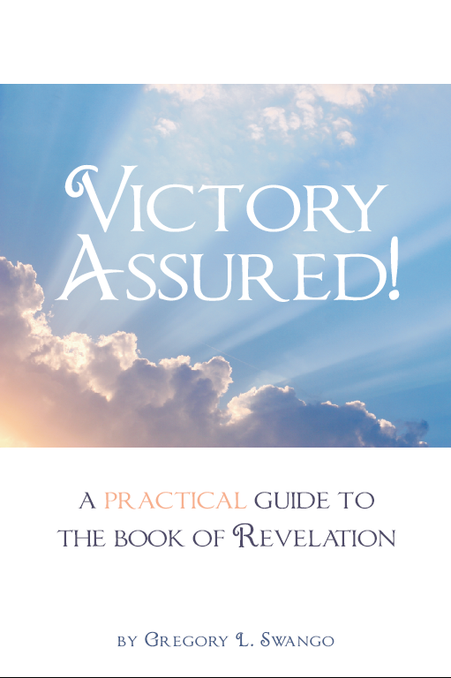

Slide 2
Lesson 01:
Overcoming with the Resurrected Savior

Slide 3
Victory Assured! Class Syllabus
Victory with Jesus Christ
1. Overcoming with the Resurrected Savior (1:9-20; 19:11-16).
2. Overcoming with the Worthy Lamb (4:1-5:14).
Victory with the Church--the Letters
3. Overcoming Apathy (2:1-7; 3:14-22).
4. Overcoming Idolatry (2:8-29)
5. Overcoming Spiritual Death (3:1-13).

Slide 4
Victory Assured! Class Syllabus
Victory Over Life’s Everyday Battles
6 Overcoming Hardship--the Seals (6:1-17).
7 Overcoming by Knowing the Warning Signs--the Trumpets (8:1-11:19).
Victory Over Worldliness
8 Overcoming Satan (12:1-17).
9 Overcoming Political Persecution (13:1-10).
10 Overcoming False Religion (13:11-18).
11 Overcoming Materialism (18:1-24).

Slide 5
Victory Assured! Class Syllabus
Eternal Victory
12 Overcoming at the Great Judgment (16:1-21; 19:1-21; 20:1-15).
13 The Joy and Rewards of Overcoming (7:1-17; 14:1-15:8; 21:1-22:21).

Slide 6
Lesson 01: Overcoming with the Resurrected Savior
OVERCOMING BY THE RISEN CHRIST
(Rev. 1:4-8)
Jesus is not dead! He has risen from the dead and is alive forevermore!
1. Jesus the faithful witness (martyr).
2. The firstborn (has the preeminence) of the dead.
3. Ruler of kings of the earth.
4. Timeless (was, is, and will be).

Slide 7
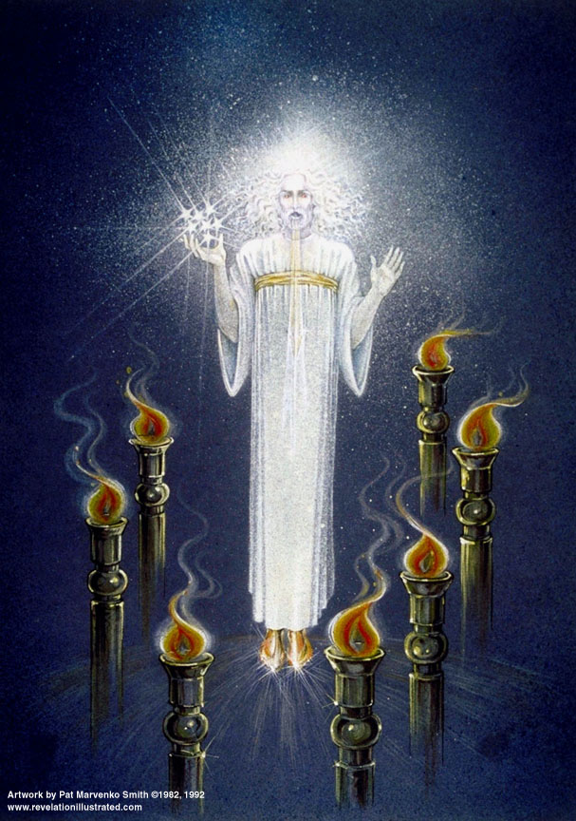

Slide 8
Lesson 01: Overcoming with the Resurrected Savior
OVERCOMING BY THE RISEN CHRIST
(Rev. 1:4-8)
Blessings to be counted because of Jesus:
1. He loved us and released us from our sins by His blood.
2. Made us to be a kingdom, priests to God the Father.
3. He has glory and dominion forever and ever.
4. He is coming (again) with the clouds.

Slide 9
Lesson 01: Overcoming with the Resurrected Savior
THE IMAGE OF THE RESURRECTED CHRIST (Rev. 1:9-20)
Twelve designations of the risen Christ:
1. The Alpha and the Omega.
2. The One who is, and who was, and who is to come.
3. I saw one like a son of man.
4. Clothed in a robe reaching to the feet.

Slide 10
Lesson 01: Overcoming with the Resurrected Savior
THE IMAGE OF THE RESURRECTED CHRIST (Rev. 1:9-20)
Twelve designations of the risen Christ:
5. Girded across His chest with a golden sash.
6. His head and His hair were white like white wool, like snow.
7. His eyes were like a flame of fire.
8. His feet were like burnished bronze, when it is made to glow in a furnace.

Slide 11
Lesson 01: Overcoming with the Resurrected Savior
THE IMAGE OF THE RESURRECTED CHRIST (Rev. 1:9-20)
Twelve designations of the risen Christ:
9. His voice was like the sound of many waters.
10.In His right hand He held seven stars.
11.Out of His mouth came a sharp two- edged sword.
12.His face was like the sun shining in its strength.

Slide 12
Lesson 01: Overcoming with the Resurrected Savior
OVERCOMING BY THE VICTORIOUS CHRIST (Rev. 19:11-21)
Jesus is riding on a white horse, which symbolizes purity. He has many crowns upon His head and His characteristic names are “Faithful and True.” His name for recognition is “The Word of God.” His robe is dipped in blood, which shows He has been to the cross and shed His blood. Now He rides into battle with a sharp sword and rod of iron. He will smite the nations and put those who oppose into the great winepress of the wrath of God. This is the victorious Christ whom we serve!

Slide 13
Lesson 01: Overcoming with the Resurrected Savior
OVERCOMING BY THE VICTORIOUS CHRIST (Rev. 19:11-21)
Notice that as He comes out to do battle there is an army following Him. They are dressed in fine linen white and clean. They also ride on white horses. The vision is thrilling and the message is clear. As we go out to do battle with the forces of evil, we follow a Christ who has overcome. We follow a Christ who has made us pure and has enlisted us into His army. We follow a Christ who can and will defeat His enemies. The real winners are those who follow this King. He will rule and reign and His people will rule and reign right behind him.

Slide 14
Lesson 01: Overcoming with the Resurrected Savior
CONCLUSION
Victory is assured! We can be winners when the world declares us to be losers. We can win in life because we are on the right side--Christ’s side.
We can live each day victoriously because we are spiritually fit for battle. We are clean and pure. Jesus leads us in triumph over our enemies (2Cor. 2:14,15).

Slide 15
Lesson 01: Overcoming with the Resurrected Savior
CONCLUSION
No need to worry. No need to give up. No need to be discouraged. Christians serve a risen Christ who will lead His people triumphantly to victory. What a great message to remember everyday!
When it is all over, Christians who are faithful to the end are the victors. We are the victors because we serve our Lord who has come back from the dead, and now leads us on to victory!

Slide 16
Lesson 02: Overcoming with the Worthy Lamb
NEXT LESSON:
Overcoming with the Worthy Lamb
(Rev. 4:1-5:14).

