Slide 2
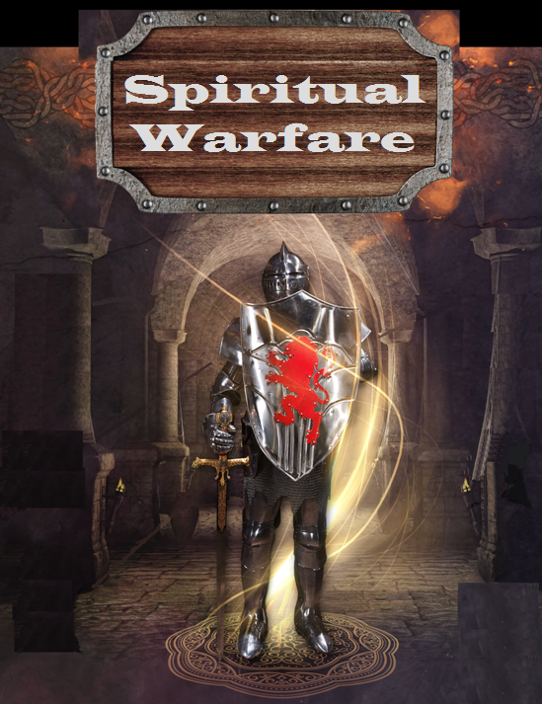

Slide 3
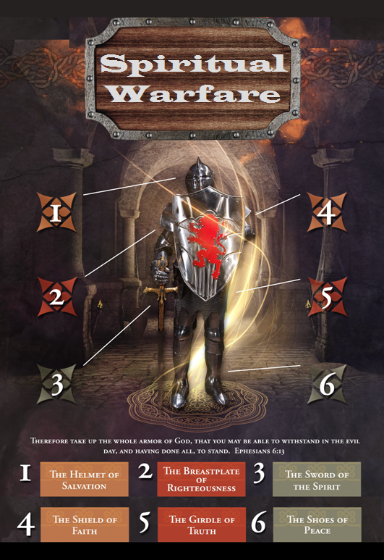

Slide 4
SPIRITUAL WARFARE
TEMPTATION
01 09-01 A Brief Look at Ephesians 6:12-18
Temptation’s 3 forms (1Jn. 2:15-17)
02 09-08 Temptations of Gen. 3 and Mt. 4; Jas 1
03 09-15 Scriptures explaining… The Lust of the Eyes
04 09-22 Scriptures explaining… The Lust of the Flesh
05 09-29 Scriptures explaining… The Pride of Life

Slide 5
SPIRITUAL WARFARE
DEFENSIVE WEAPONS
06 10-06 Defensive Weapons: Girdle and Breastplate
07 10-13 Defensive Weapons: Shoes and Shield
08 10-20 Defensive Weapons: Helmet and Sword

Slide 6
SPIRITUAL WARFARE
OFFENSIVE WEAPONS
09 10-27 Offensive Weapons: Prayer
10 11-03 Offensive Weapons: Praise
11 11-10 Offensive Weapons: Preaching
12 11-17 Offensive Weapons: Posture
13 11-24 Victory! (The Basis of Our Victory)

Slide 7
SPIRITUAL WARFARE
OFFENSIVE WEAPON OF POSTURE (Lifestyle)
Ten Guidelines for Good Spiritual Health
Some Scriptures Concerning Posture (Lifestyle)
All verses are from the
New American Standard Bible unless otherwise cited.

Slide 8
SPIRITUAL WARFARE
OFFENSIVE WEAPON OF POSTURE (Lifestyle)
Ten Guidelines for Good Spiritual Health:
1. Read your Bible daily.
Acts 17:11
2. Learn the secret of prayer.
Matthew 6:5-7

Slide 9
SPIRITUAL WARFARE
OFFENSIVE WEAPON OF POSTURE (Lifestyle)
Ten Guidelines for Good Spiritual Health:
3. Rely on God’s providence.
Romans 8:28
4. Attend church regularly.
Hebrews 3:12-13; 10:24-25

Slide 10
SPIRITUAL WARFARE
OFFENSIVE WEAPON OF POSTURE (Lifestyle)
Ten Guidelines for Good Spiritual Health:
5. Be a “witnessing” Christian.
1Thessalonians 1:6-8
6. Let love be the ruling principle of your life.
John 13:35; 1John 4:7-9

Slide 11
SPIRITUAL WARFARE
OFFENSIVE WEAPON OF POSTURE (Lifestyle)
Ten Guidelines for Good Spiritual Health:
7. Be an obedient Christian.
1Peter 1:22
8. Learn how to meet temptation.
1Corinthians 10:13

Slide 12
SPIRITUAL WARFARE
OFFENSIVE WEAPON OF POSTURE (Lifestyle)
Ten Guidelines for Good Spiritual Health:
9. Be a wholesome Christian.
Philippians 1:27-28
10. Live above your circumstances.
Philippians 4:10-13

Slide 13
SPIRITUAL WARFARE
OFFENSIVE WEAPON OF POSTURE (Lifestyle)
Some Scriptures Concerning Posture:
Matthew 11:25
Luke 6:35
Acts 3:19
Romans 12:17
2Corinthians 9:7
Ephesians 4:3; 4:25
Philippians 4:6
Hebrews 13:2

Slide 14
SPIRITUAL WARFARE
NEXT WEEK:
THE FULL ARMOR OF GOD
(Eph. 6:10-20)
OFFENSIVE WEAPONS…
Victory! The Basis of Our Victory
blank

