Slide 3
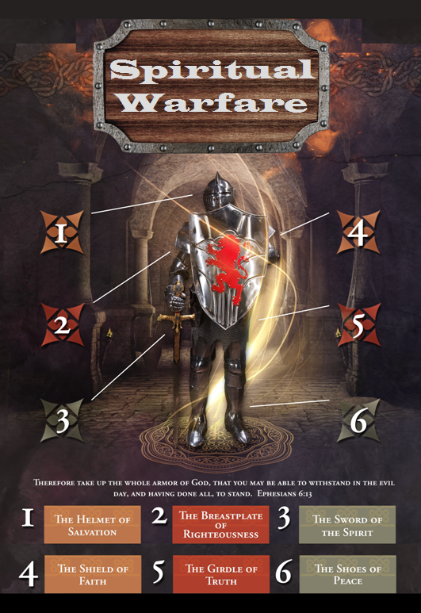

Slide 4
SPIRITUAL WARFARE
TEMPTATION
01 09-01 A Brief Look at Ephesians 6:12-18
Temptation’s 3 forms (1Jn. 2:15-17)
02 09-08 Temptations of Gen. 3 and Mt. 4; Jas 1
03 09-15 Scriptures explaining… The Lust of the Eyes
04 09-22 Scriptures explaining… The Lust of the Flesh
05 09-29 Scriptures explaining… The Pride of Life

Slide 5
SPIRITUAL WARFARE
DEFENSIVE WEAPONS
06 10-06 Defensive Weapons: Girdle and Breastplate
07 10-13 Defensive Weapons: Shoes and Shield
08 10-20 Defensive Weapons: Helmet and Sword

Slide 6
SPIRITUAL WARFARE
OFFENSIVE WEAPONS
09 10-27 Offensive Weapons: Prayer
10 11-03 Offensive Weapons: Praise
11 11-10 Offensive Weapons: Preaching
12 11-17 Offensive Weapons: Posture
13 11-24 Victory! (The Basis of Our Victory)

Slide 7
SPIRITUAL WARFARE
OFFENSIVE WEAPON OF PRAISE
Eight Hebrew Words for Praise
Some Scriptures concerning Praise to God
blank
All verses are from the
New American Standard Bible unless otherwise cited.

Slide 8
SPIRITUAL WARFARE
OFFENSIVE WEAPON OF PRAISE
Eight Hebrew words for Praise:
1. Hallah.
The most common word for praise.
Psalm 63:3,4
2. Yadah.
To worship with extended hands.
Psalm 134:2; 43:1-5; 134:2
2Chronicles 20:1-21
Nehemiah 8:6; 1Timothy 2:8

Slide 9
SPIRITUAL WARFARE
OFFENSIVE WEAPON OF PRAISE
Eight Hebrew words for Praise:
3. Barak.
Used to denote a blessing.
Job 1:21; Judges 5:1-2
Psalm 72:15
4. Tehillah.
To sing or to laud.
Psalm 22:3; Exodus 15:2; Isaiah 61:3
Deuteronomy 10:21

Slide 10
SPIRITUAL WARFARE
OFFENSIVE WEAPON OF PRAISE
Eight Hebrew words for Praise:
5. Zamar.
To pluck the strings of an instrument.
Psalm 18:1-3
Nehemiah 8:10; Psalm 18:46-50; 68:1-4
Ephesians 5:19
6. Todah.
To shout or address with a loud voice.
Psalm 56:1-12

Slide 11
SPIRITUAL WARFARE
OFFENSIVE WEAPON OF PRAISE
Eight Hebrew words for Praise:
7. Shabach.
To to shout or address in a loud tone.
Daniel 4:37
8. Hallelujah.
The premier word for praise in the Bible.
Hallel means to boast or brag.
Jah is the short form of the name of God.
Revelation 19:1-7

Slide 12
SPIRITUAL WARFARE
THE OFFENSIVE WEAPON OF PRAISE
Scriptures concerning praise to God:
Psalm 9:14; 22:3,22; 35:18; 35:28; 42:11; 51:15
Matthew 11:25
Luke 2:13; 18:43
Acts 2:47; Romans 15:9-11
Ephesians 1:6; Philippians 4:8
Hebrews 2:12; 13:15
James 5:13
Revelation 19:5

Slide 13
SPIRITUAL WARFARE
NEXT WEEK:
THE FULL ARMOR OF GOD
(Eph. 6:18-20)
OFFENSIVE WEAPONS…
Preaching
blank

