Slide 3
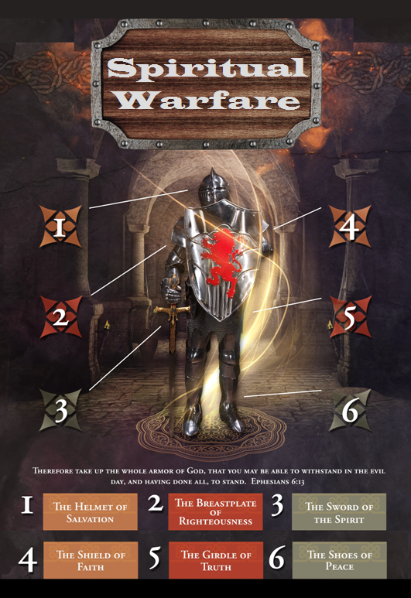

Slide 4
SPIRITUAL WARFARE
TEMPTATION
01 09-01 A Brief Look at Ephesians 6:12-18
Temptation’s 3 forms (1Jn. 2:15-17)
02 09-08 Temptations of Gen. 3 and Mt. 4; Jas 1
03 09-15 Scriptures explaining… The Lust of the Eyes
04 09-22 Scriptures explaining… The Lust of the Flesh
05 09-29 Scriptures explaining… The Pride of Life

Slide 5
SPIRITUAL WARFARE
DEFENSIVE WEAPONS
06 10-06 Defensive Weapons: Girdle and Breastplate
07 10-13 Defensive Weapons: Shoes and Shield
08 10-20 Defensive Weapons: Helmet and Sword

Slide 6
SPIRITUAL WARFARE
OFFENSIVE WEAPONS
09 10-27 Offensive Weapons: Prayer
10 11-03 Offensive Weapons: Praise
11 11-10 Offensive Weapons: Preaching
12 11-17 Offensive Weapons: Posture
13 11-24 Victory! (The Basis of Our Victory)

Slide 7
SPIRITUAL WARFARE
THE SHOES AND SHIELD
The Shoes (of the preparation of the Gospel)
The Shield of Faith
blank
All verses are from the
New American Standard Bible unless otherwise cited.

Slide 8
SPIRITUAL WARFARE
THE SHOES
The need for preparation
1Peter 3:15
Scriptures concerning the Gospel:
Matthew 4:23; 11:5
Mark 8:35; 10:29-30; 16:15-16
Luke 16:16
Romans 1:16
1Corinthians 15:1-4; 2Corinthians 4:3-4
Galatians 1:6-9; Ephesians 1:13
Philippians 1:27; 2Thessalonians 2:14blank

Slide 9
SPIRITUAL WARFARE
THE SHIELD OF FAITH
Types of Faith:
Common Titus 1:4
Weak Romans 4:19
Strong Romans 4:20
Little Matthew 6:30
Great Matthew 8:10
Sincere 1Timothy 1:5
Inactive/Active James 2:14-26
Wavering James 1:5-8
Unwavering Hebrew 10:23

Slide 10
SPIRITUAL WARFARE
THE SHIELD OF FAITH
Scriptures concerning faith:
Habakkuk 2:4
Romans 10:17
1Corinthians 2:5; 13:13
2Corinthians 5:7
Galatians 2:20; 3:24-26
Ephesians 2:8
Colossians 2:5-7
1Timothy 1:5; 4:12
2Timothy 4:7

Slide 11
SPIRITUAL WARFARE
NEXT WEEK:
THE FULL ARMOR OF GOD
(Eph. 6:10-17)
DEFENSIVE WEAPONS…
The Helmet and the Sword
blank

