Slide 2
Hermeneutics
Rightly Dividing the Word of God
Methods, Rules and Principles of Interpretation
Review
The Need for a Method.
Harmful Methods.
The Deductive Method.
Rules of Interpretation.
A Proper Attitude.

Slide 3
Hermeneutics
Rightly Dividing the Word of God
Types of Language Used
The Importance of the Setting
A. Who is doing the speaking or the writing?
B. To whom is the command or observation given?
C. About whom is the passage speaking?
D. When was the passage in question spoken?
E. Where was the speaker when the message was given?
F. What were the circumstances about the statement spoken?
G. Why is the passage included in its context?

Slide 4
Hermeneutics
Rightly Dividing the Word of God
Types of Language Used
Figures of Speech
1. Parable. 7. Hyperbole.
2. Fable. 8. Irony and Sarcasm.
3. Simile. 9. Interrogation.
4. Metaphor. 10. Metonymy.
5. Allegory. 11. Personification.
6. Riddle. 12. Anthropomorphism.

Slide 5
Hermeneutics
Rightly Dividing the Word of God
Types of Language Used
Types of Language Used
A. Literal language.
It means what is says and says what it means.
B. Figurative language.
“A symbol used to tell a story.”
When do I interpret a passage figuratively?

Slide 6
Hermeneutics
Rightly Dividing the Word of God
Semantics
The Need to Interpret
A. The Nature of Scripture:
What did it say/mean back then?
What does it say/mean now?
B. The Value of Semantics Denotative and Connotation Meanings.
C. The Triangle of Meaning.
The referent, the symbol, and the reference.

Slide 7
Hermeneutics
Rightly Dividing the Word of God
Semantics
The Triangle of Meaning
A. Four Attributes of Human Utterance.
1. Sense (Mt. 7:29).
2. Feeling (Mt. 5:17-20).
3. Tone (Mt. 9:36-38; 23:27).
4. Intention (Jn. 14:1-6).

Slide 8
Hermeneutics
Rightly Dividing the Word of God
Hermeneutics
Theme verse
Nehemiah 8:8 --
They read from the book, from the law of God,
translating to give the sense
so that they understood the reading.

Slide 9
Hermeneutics
Rightly Dividing the Word of God
LESSON FIVE:
The Law of Moses and the OT Narratives

Slide 10
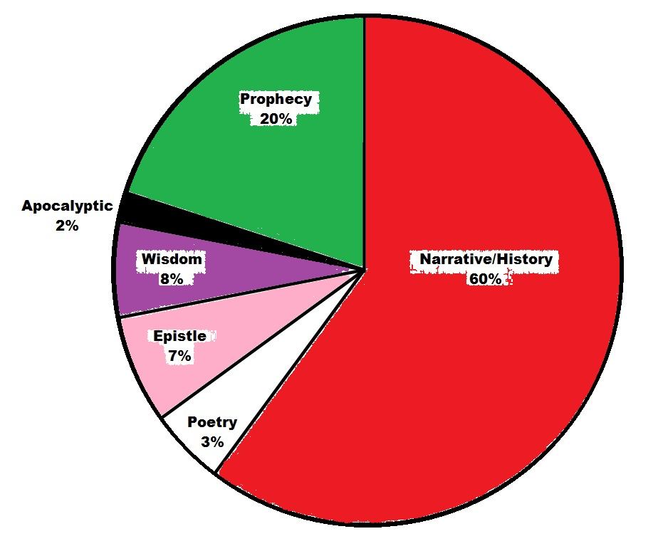
Hermeneutics
Rightly Dividing the Word of God
The Law of Moses and the OT Narratives
The Genres of the Bible

Slide 11
Hermeneutics
Rightly Dividing the Word of God
The Law of Moses and the OT Narratives
How to Interpret the Law
A. Two kinds of Law:
1. Apodictic Law (direct commands).
2. Casuistic Law (conditional via case by case).
B. Christians and the Old Law:
1. The OT Law is a covenant.
2. The OT is not our testament.
3. The OT is for our learning
(Rom. 15:4; 1Cor. 10:11; 2Tim. 3:15).
C. The Old Covenant and the Ordinances:
(1Kgs. 8:9,21; Col. 2:14; Eph. 2:15).

Slide 12
Hermeneutics
Rightly Dividing the Word of God
The Law of Moses and the OT Narratives
How to Interpret the Narratives
A. What the Narratives are (three levels):
1. Top: God’s universal plan worked out.
2. Middle: The story of Israel.
3. Bottom: Hundreds of individual narratives.
B. What the Narratives are not:
1. Not just stories about OT people.
2. Not allegories or stories with hidden meaning.
3. They do not always teach directly.
4. They do not each have a moral of its own.

Slide 13
Hermeneutics
Rightly Dividing the Word of God
The Law of Moses and the OT Narratives
How to Interpret the Narratives
A. What the Narratives are (three levels).
B. What the Narratives are not.
C. Warnings and Conclusions:
1. Implicit does not mean secret!
2. No OT narrative was written about you.
3. Narratives show God’s providence in the world.

Slide 14
Hermeneutics
Rightly Dividing the Word of God
NEXT TIME…
The OT Psalms and Wisdom Literature
A. The Psalms as Poetry.
The Psalms as Literature.
Types of Psalms.
Benefits of the Psalms.
B. How to Interpret the Wisdom Literature.
The nature of Wisdom.
Ecclesiastes.
Job.
Proverbs.

