Slide 2
Hermeneutics
Rightly Dividing the Word of God
Hermeneutics
Theme verse
Nehemiah 8:8 --
They read from the book, from the law of God,
translating to give the sense
so that they understood the reading.

Slide 3
Hermeneutics
Rightly Dividing the Word of God
LESSON THREE:
Types of Language Used

Slide 4
Hermeneutics
Rightly Dividing the Word of God
Types of Language Used
Periods of Revelation
A. The Patriarchal Period (from Adam to Moses).
B. The Mosaic Period (from Moses to Malachi).
C. The Christian Period (from Christ to the end of time).

Slide 5
Hermeneutics
Rightly Dividing the Word of God
Types of Language Used
Different Literary Genres
A. The Law.
Some of the covenant stipulations for OT Israel.
B. The Old Testament Narratives.
Over 40% of the OT is in narrative form.
C. The Psalms.
Instead of God speaking to man, it is man speaking to God. Israel’s prayers and ours.
D. The Wisdom Literature.
A very special look at Ecclesiastes, Proverbs and Job.

Slide 6
Hermeneutics
Rightly Dividing the Word of God
Types of Language Used
Different Literary Genres
E. The Prophets.
The fore-tellers and forth-tellers of Israel. How they tried to get the people to follow the Law.
F. The Gospels.
One story with many dimensions and different audiences.
G. The Parables.
“Do you get the point?”

Slide 7
Hermeneutics
Rightly Dividing the Word of God
Types of Language Used
Different Literary Genres
H. The Book of Acts.
Understanding how one handles examples and the historical precedent in the book is important.
I. The Epistles.
Public letters written to God’s people trying to help them with specific problems.
J. The Revelation.
Apocalyptic literature also includes Ezekiel, Daniel, and Zechariah.

Slide 8
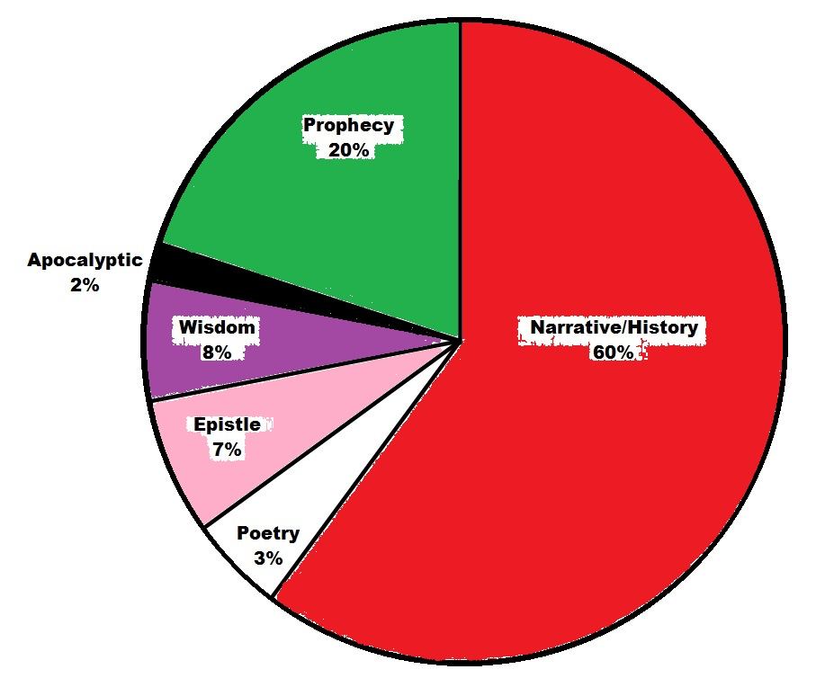
Hermeneutics
Rightly Dividing the Word of God

Slide 9
Hermeneutics
Rightly Dividing the Word of God
Types of Language Used
The Importance of the Setting
A. Who is doing the speaking or the writing?
B. To whom is the command or observation given?
C. About whom is the passage speaking?
D. When was the passage in question spoken?
E. Where was the speaker when the message was given?
F. What were the circumstances about the statement spoken?
G. Why is the passage included in its context?

Slide 10
Hermeneutics
Rightly Dividing the Word of God
Types of Language Used
Types of Language Used
A. Literal language.
It means what is says and says what it means.
B. Figurative language.
“A symbol used to tell a story.”
When do I interpret a passage figuratively?

Slide 11
Hermeneutics
Rightly Dividing the Word of God
Types of Language Used
Types of Language Used
Figurative language.
Interpret a passage figuratively if:
1. It involves an impossibility or an absurdity (Lk. 9:60).
2. It involves a contradiction or inconsistency (Jn. 11:25,26).
3. It involves an immoral conclusion (Mt. 18:8,9).
4. It implies its meaning from the context (Rev. 7:14).
5. It is plainly stated to interpret it figuratively (Jn. 2:18-21).
6. It is more apt to be figurative for the reason of common sense (Jn. 4:10-15).

Slide 12
Hermeneutics
Rightly Dividing the Word of God
Types of Language Used
Types of Language Used
Figurative language.
Some rules for understanding figurative language:
1. Determine what kind of figure (of speech) it is.
2. If possible, follow the author’s explanation (Lk. 8:11).
3. Try to harmonize the figurative with the literal.
4. Try to harmonize the figurative with the custom of the times.
5. Do not press the meaning too far. The details may not be as important as you think.
6. Remember that figures of speech change over the years.

Slide 13
Hermeneutics
Rightly Dividing the Word of God
Types of Language Used
Figures of Speech
1. Parable. 7. Hyperbole.
2. Fable. 8. Irony and Sarcasm.
3. Simile. 9. Interrogation.
4. Metaphor. 10. Metonymy.
5. Allegory. 11. Personification.
6. Riddle. 12. Anthropomorphism.

Slide 14
Hermeneutics
Rightly Dividing the Word of God
Types of Language Used
Figures of Speech
1. Parable.
A simple, normal real life story or illustration used to present a moral truth (Lk. 10:25-37; 15:11-32).
2. Fable.
Similar to a parable but made up of fictitious or imaginary characters or story (2Kgs. 14:8-10; Jud. 9:7-15).

Slide 15
Hermeneutics
Rightly Dividing the Word of God
Types of Language Used
Figures of Speech
3. Simile.
A comparison using the terms “like” or “as” (Mt. 3:16; Isa. 1:18; 53:6).
4. Metaphor.
A comparison made because of a likeness involved (Lk. 13:32; Mt. 26:26).

Slide 16
Hermeneutics
Rightly Dividing the Word of God
Types of Language Used
Figures of Speech
5. Allegory.
A metaphor extended into a story to illustrate some truth (Gal. 4:21-31; Eph. 6:11-17).
6. Riddle.
An analogy written up as a puzzle (Jud. 14:14).
7. Hyperbole.
An exaggeration of some statement for the purpose of emphasis (Num. 13:33; 1Sam. 13:5).

Slide 17
Hermeneutics
Rightly Dividing the Word of God
Types of Language Used
Figures of Speech
8. Irony and sarcasm.
A sharp remark uttered in contempt or in ridicule (Mt. 27:29; Mk. 15:29-32).
9. Interrogation.
To question for effect, often not seeking an answer (Heb. 2:3; 1Cor. 9:1; Isa. 40:12-14).
10. Metonymy.
To substitute one word for another (1Cor. 11:25,26; Ac. 15:21).

Slide 18
Hermeneutics
Rightly Dividing the Word of God
Types of Language Used
Figures of Speech
11. Personification.
A figure where inanimate being have personal attributes (Psa. 114:3; Isa. 55:12).
12. Anthropomorphism.
The ascribing of human forms or attributes to God (Ex. 33:22,23).

Slide 19
Hermeneutics
Rightly Dividing the Word of God
NEXT TIME…
Semantics
A. The Need to Interpret.
The nature of Scripture. The Value of Semantics.
B. The Triangle of Meaning.
The symbol, referent and reference.
C. The Four Attributes of Human Utterance.
Sense, Feeling, Tone, and Intention.

